Slide 1
Bus tracking android application
Submitted By: Ayush Rastogi (20CS3017)
Submitted To: Dr. Susham Biswas (H.O.D CSE)
(Assistant Professor)

Slide 2
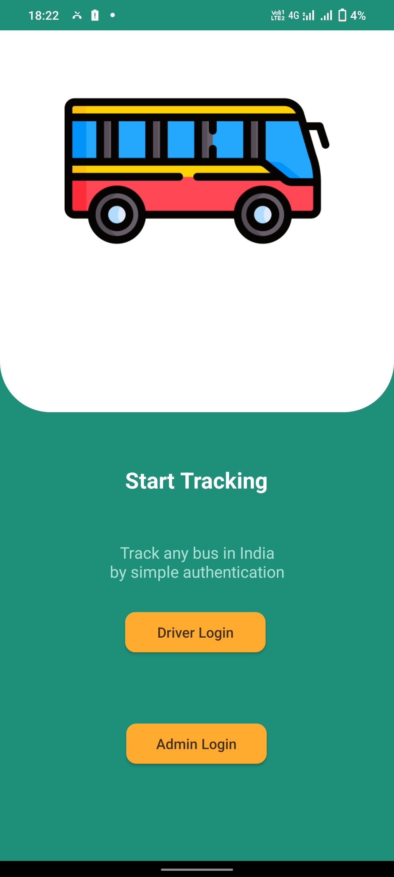
Main interface
The main interface consists of two logins
Driver Login
Admin Login

Slide 3
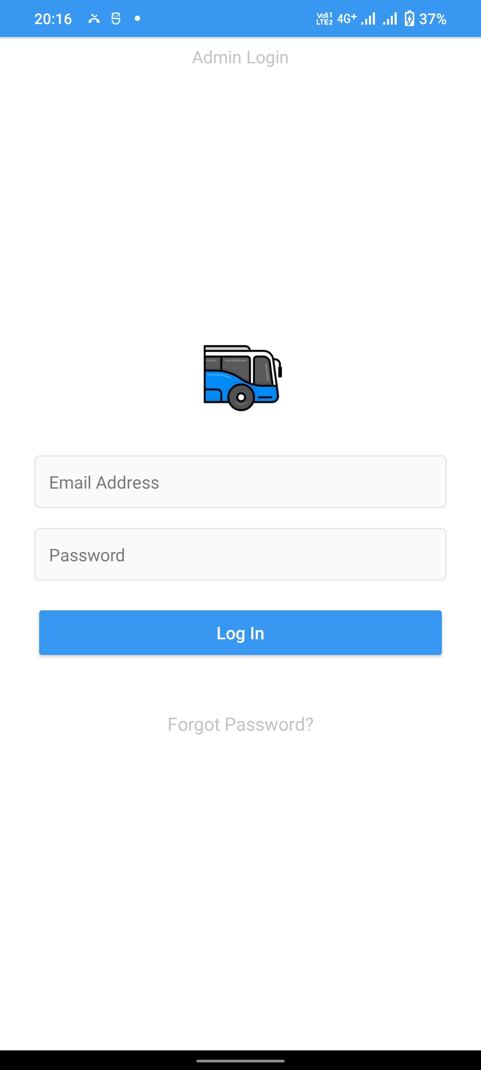
Admin LOG IN
Admin will log in with his/her email address and password. The authentication of the admin will be done using the firebase authentication protocol.

Slide 4
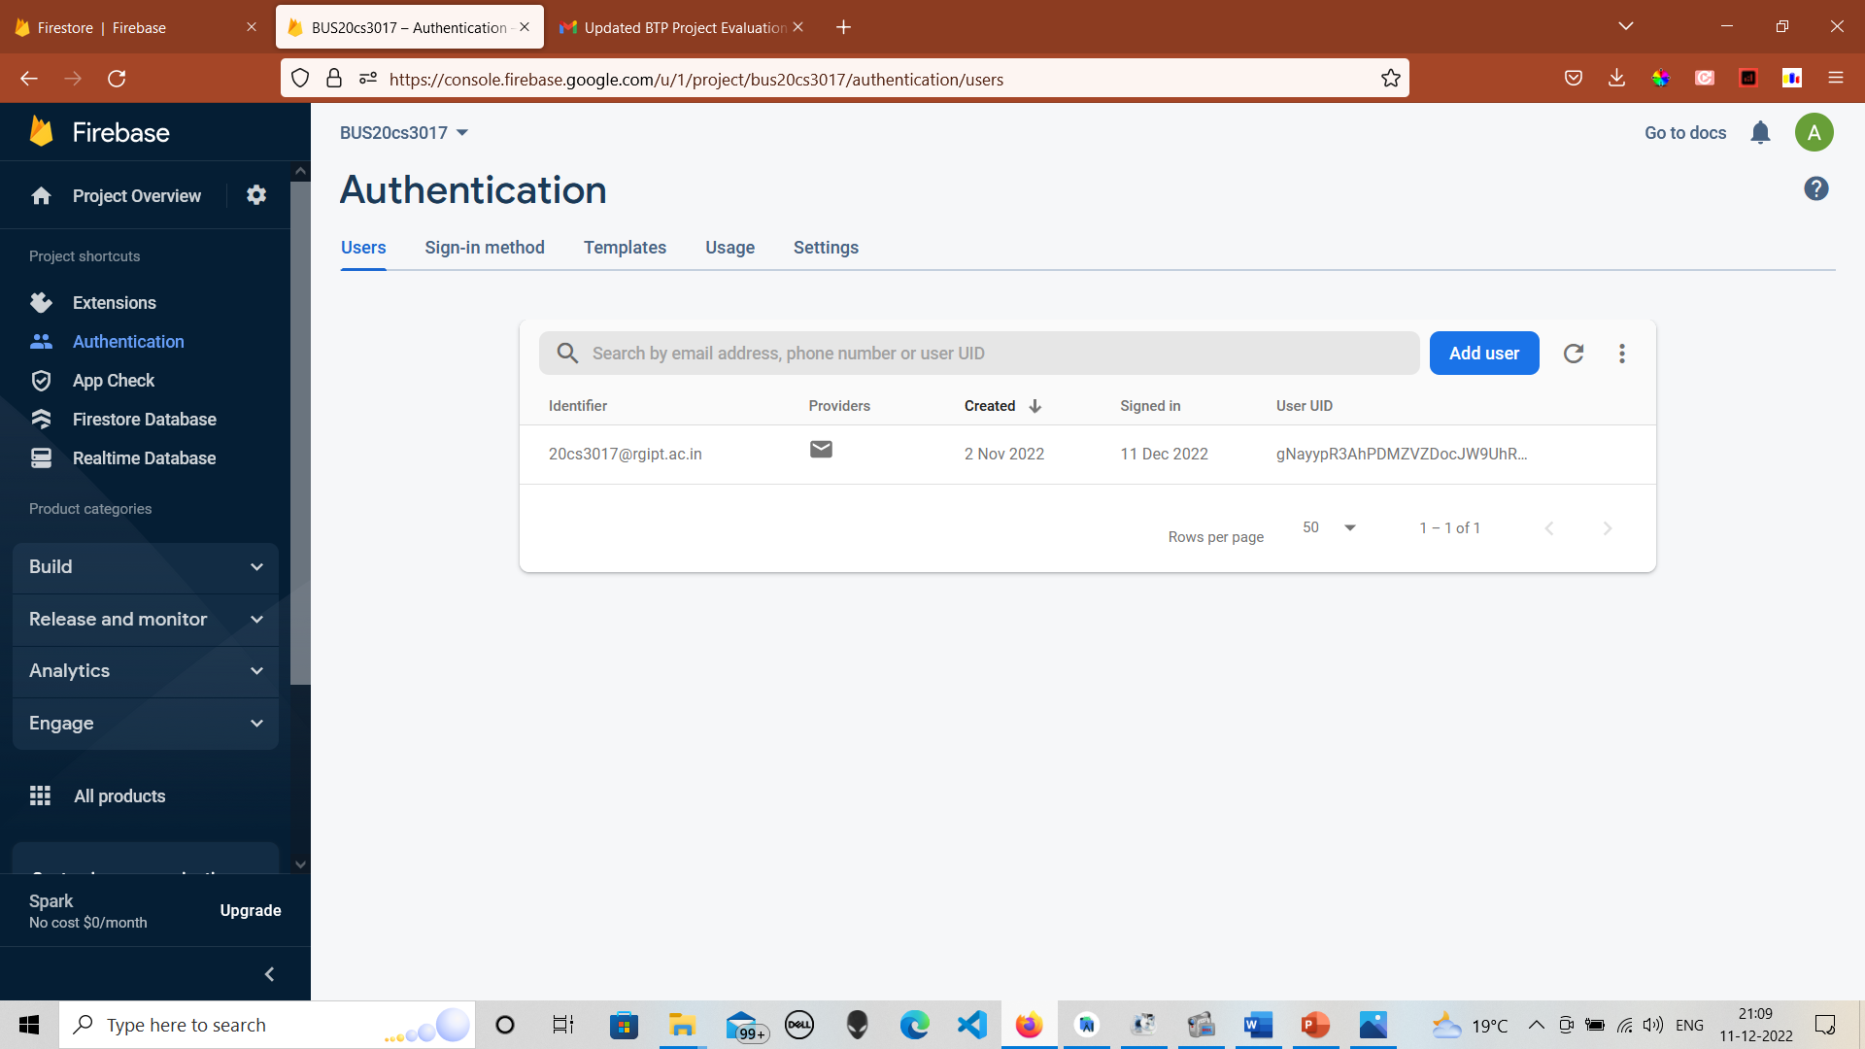
FIREBASE ADMIN AUTHENTICATION
The image shown shows the authentication of the admin email address. Currently, I have added only my college email address for admin rights. I can add more admins emails just by clicking on Add user button

Slide 5
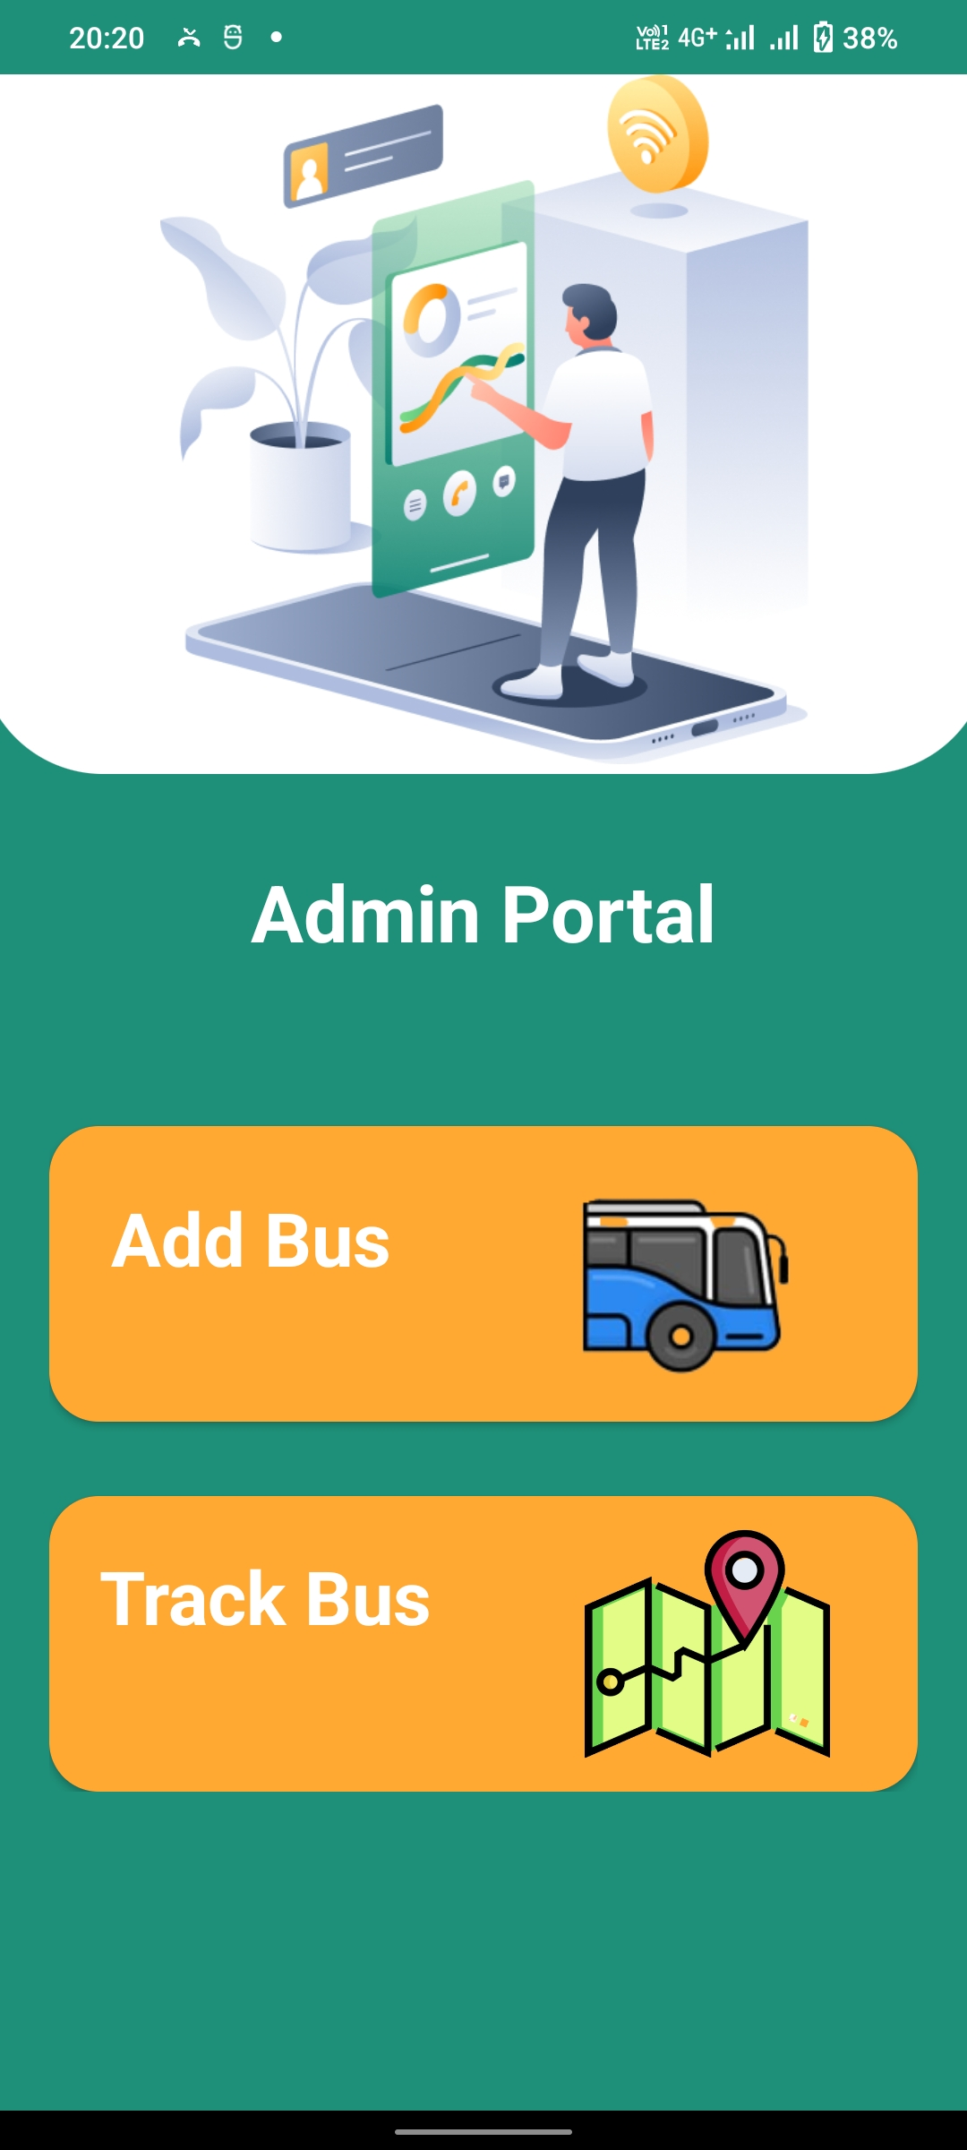
Admin interface
After the successful login of the admin, the admin can add a bus or track a bus. For tracking any bus first admin needs to add the bus by filling in all the details including bus number, driver name, license number, and password.

Slide 6
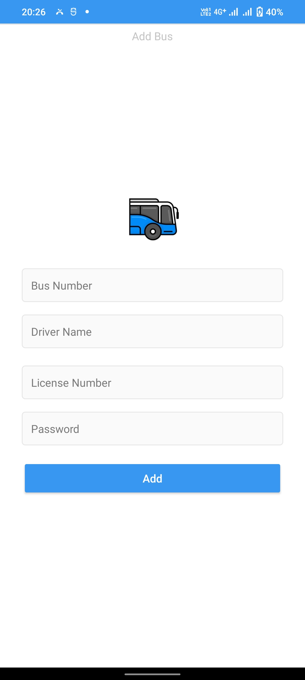
Add bus
The admin needs to fill in all the details including bus number, driver name, license number, and password, and then click on add button. The data will then be saved in the Google Cloud Firestore database with the collection name Buses.

Slide 7
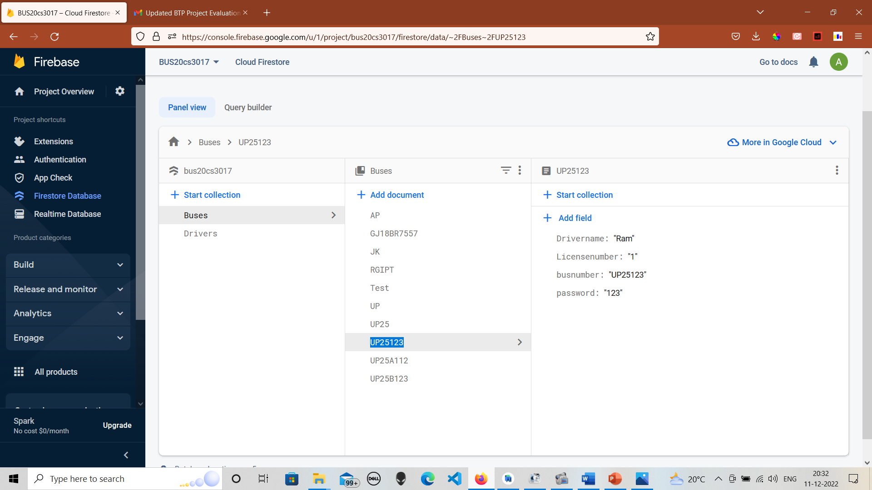
FIRESTORE COLLECTION PATH BUSES
The image shown shows my Firestore account in which the collection of Buses stores all the registered buses

Slide 8
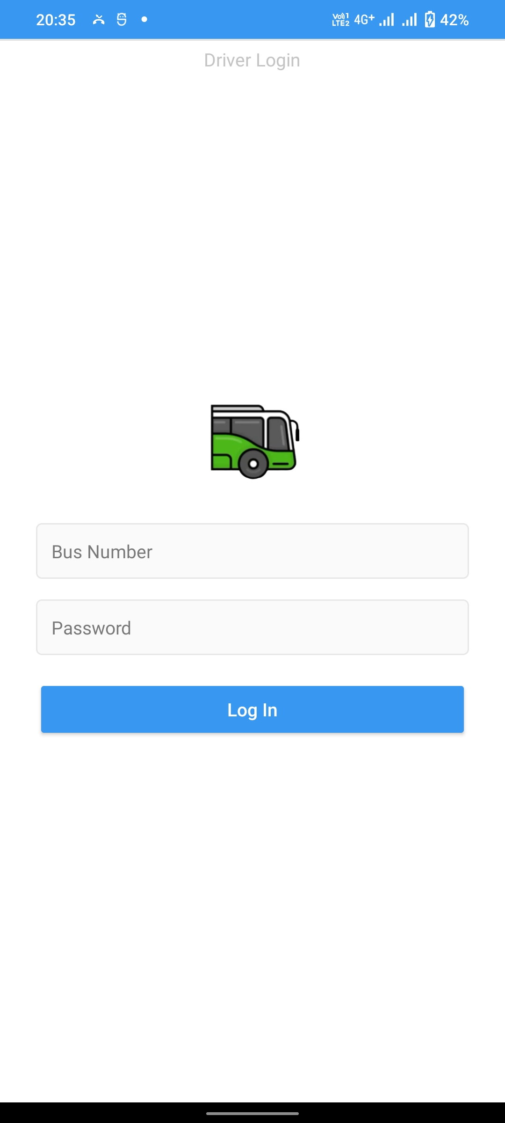
Driver log in
The driver needs to login into the driver login portal using the bus number and the password provided by the admin. The authentication of the driver is done by using the Firestore database which checks whether any bus with entered bus number or password exists or not.

Slide 9
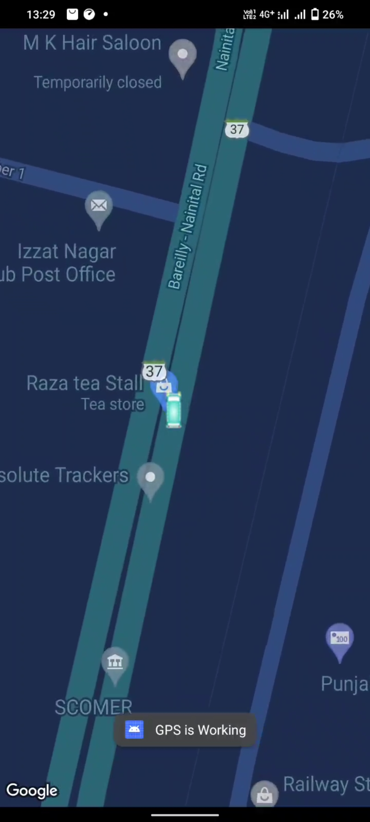
DRIVER INTERFACE
After the login of the driver is successful, the driver’s location will get updated in the Firestore database and the driver’s latitude and longitude will be saved in the collection named Drivers in my Firebase account.
The driver can see his live bus moving in the Google Maps

Slide 10
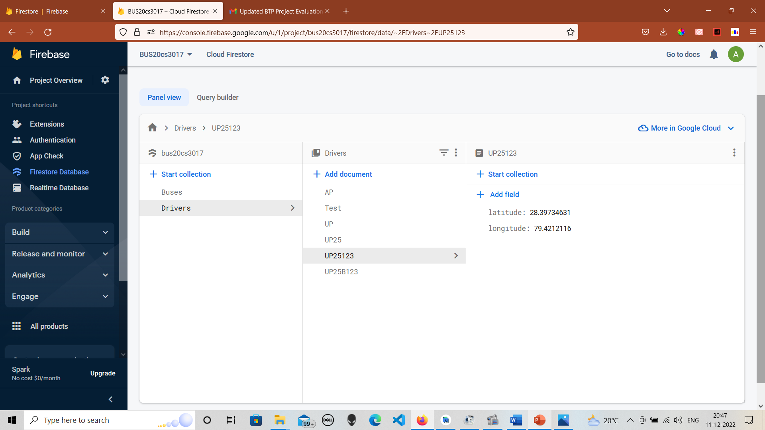
Firestore collection path drivers
The image shown shows the Driver collection path in my Firestore account storing the details of the latitude and longitude of all the buses.

Slide 11
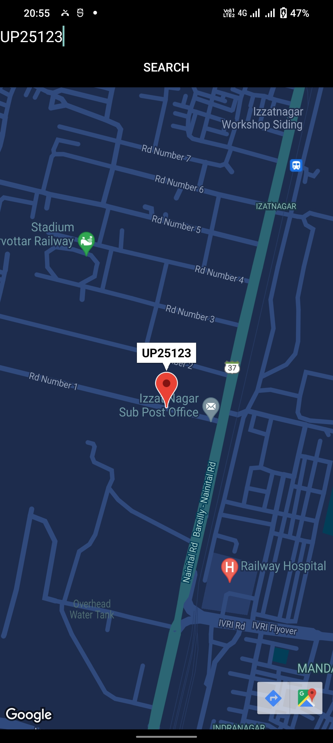
Track bus
The admin can track the bus, and the location of the bus will be displayed in Google Maps. The marker shows the most updated location of the bus along with the bus number on top of it.

Slide 12
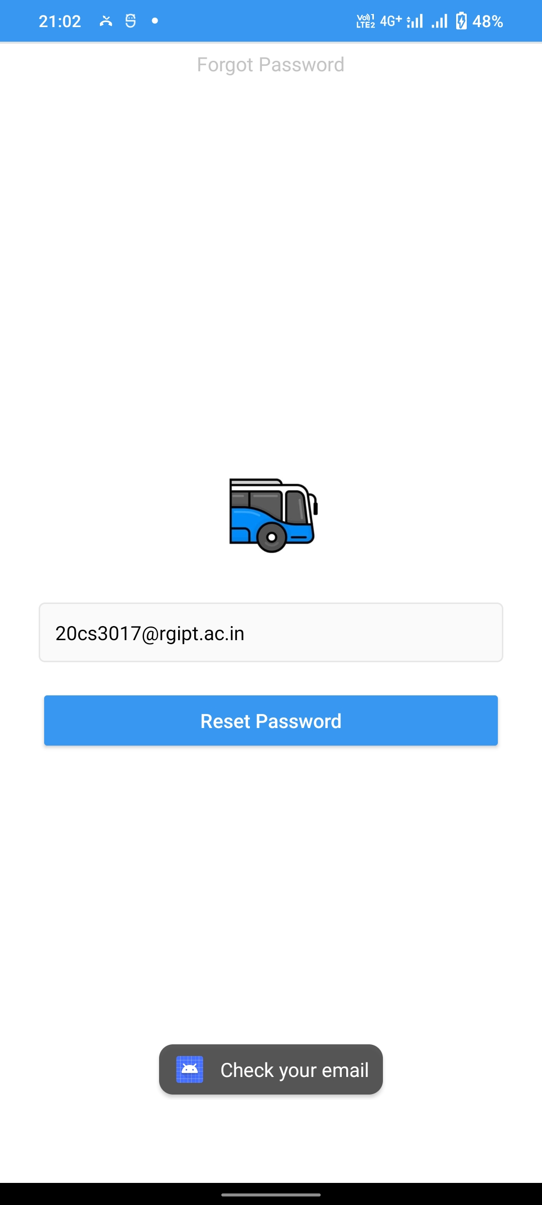
FORGOT PASSWORD
In case the admin forgets his/her password he/she can reset it by simply typing his/her email address.
An email link will be sent to the admin email address

Slide 13
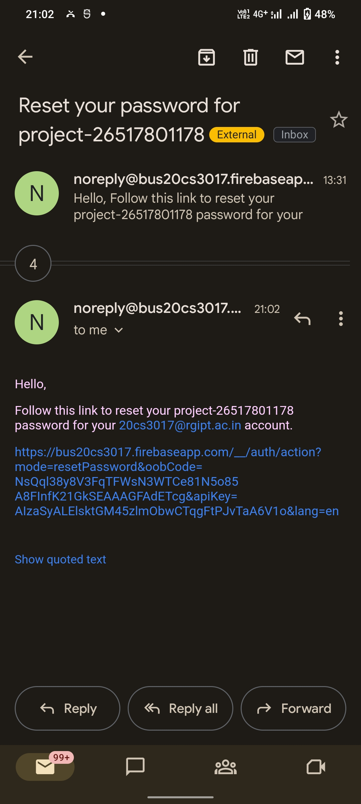
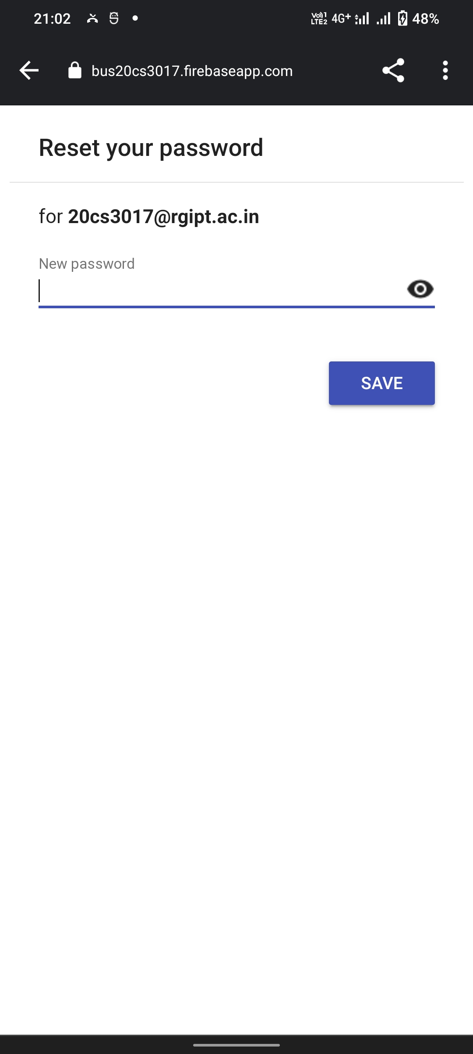
EMAIL LINK
The image shown shows the reset password link.
Admin can reset the password simply by clicking on the link.

Slide 14
VIDEO PRESENTATION OF THE PROJECT
https://drive.google.com/file/d/1O-RcB608SKyspDCFfzyb-gqAdmvj2EYP/view?usp=sharing

Slide 15
Source code explanation
https://drive.google.com/file/d/1xb5uBbWFcjJP4S1ZlWgRi0c4MqMBYWnj/view?usp=sharing

Slide 16


